Slide 1
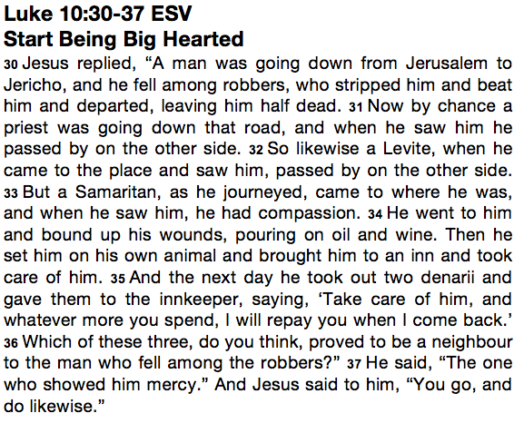
Caring

Slide 2
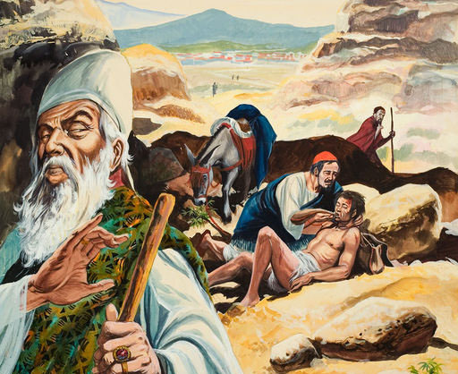

Slide 3

Hope

Slide 4
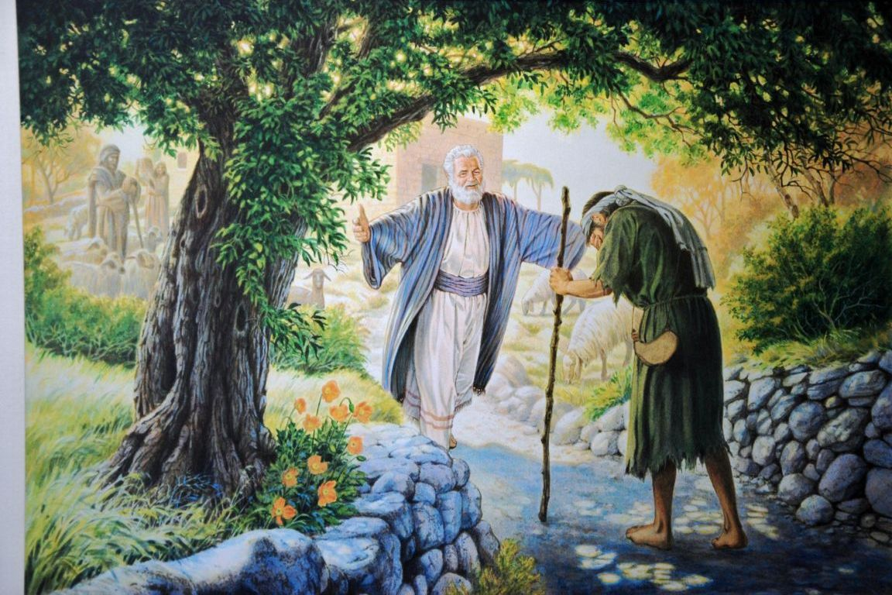

Slide 5

Understanding

Slide 6
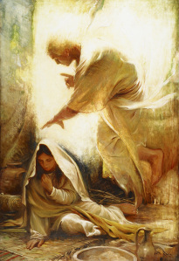

Slide 7

Respect

Slide 8
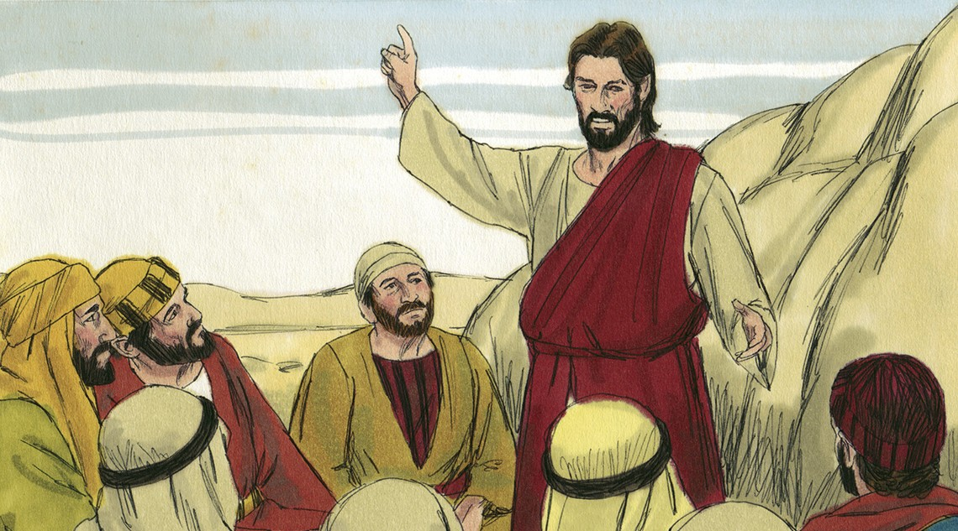

Slide 9

Co-operation

Slide 10
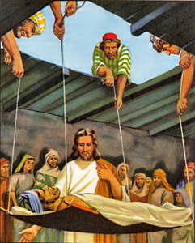

Slide 11

Happiness

Slide 12


